Slide 1

Unlike English, Spanish has two words that mean for: por and para. These two prepositions are not interchangeable. Study the following charts to see how they are used.
Por and para are most commonly used to describe aspects of movement, time, and action, but in different circumstances.
© by Vista Higher Learning, Inc. All rights reserved.
2.2-<number>

Slide 2
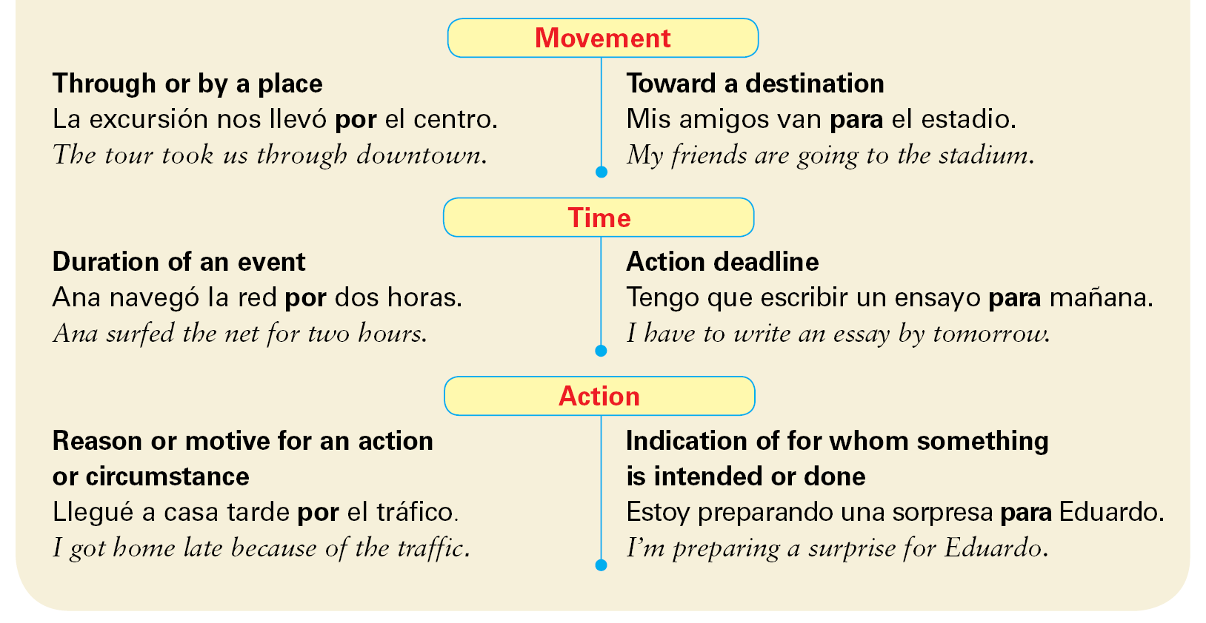
© by Vista Higher Learning, Inc. All rights reserved.
2.2-<number>

Slide 3
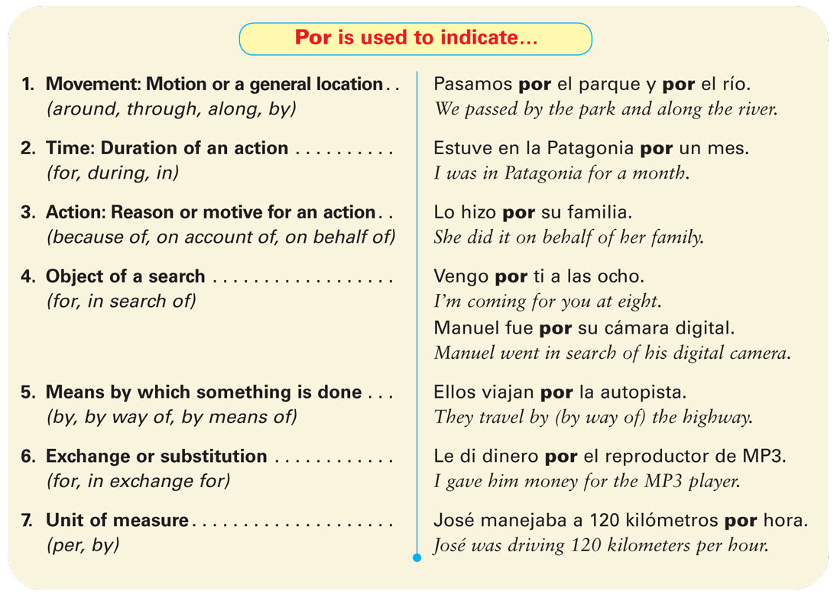
Here is a list of all of the uses of
por and para.
© by Vista Higher Learning, Inc. All rights reserved.
2.2-<number>

Slide 4
© by Vista Higher Learning, Inc. All rights reserved.
2.2-<number>

Slide 5
¡Atención! Por is also used in several idiomatic expressions, including:
por aquí around here
por ejemplo for example
por eso that’s why; therefore
por fin finally
© by Vista Higher Learning, Inc. All rights reserved.
2.2-<number>

Slide 6
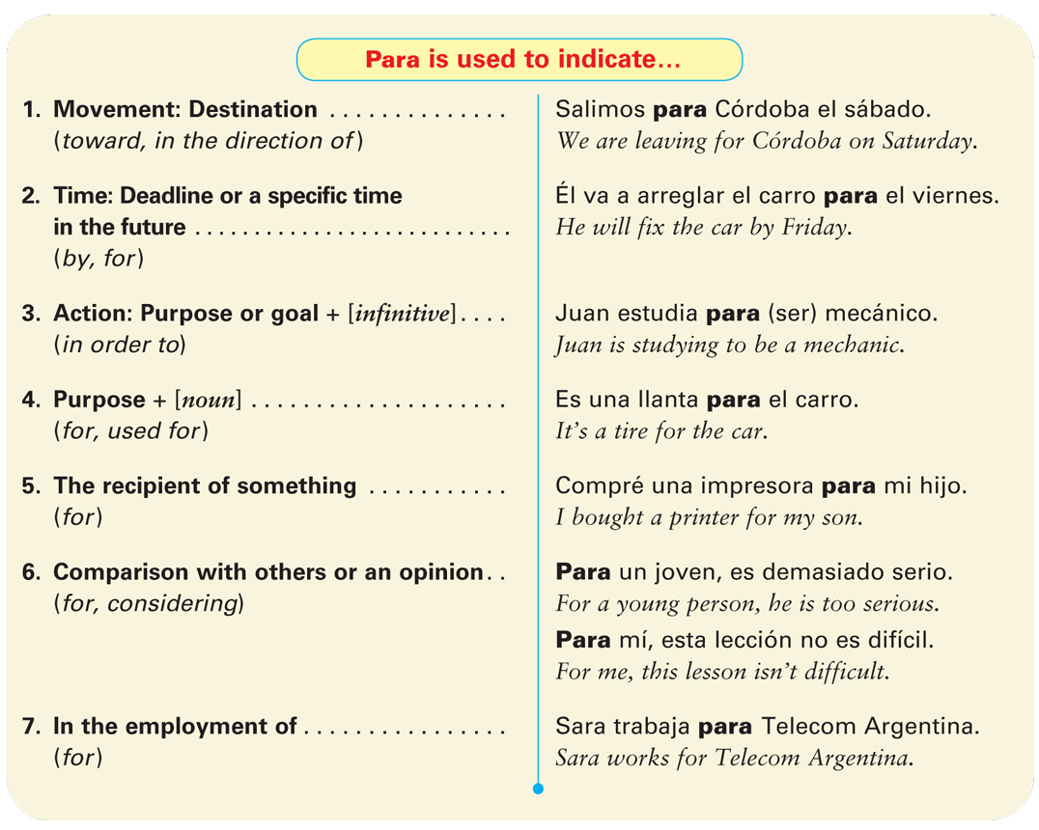
© by Vista Higher Learning, Inc. All rights reserved.
2.2-<number>

Slide 7
© by Vista Higher Learning, Inc. All rights reserved.
2.2-<number>

Slide 8
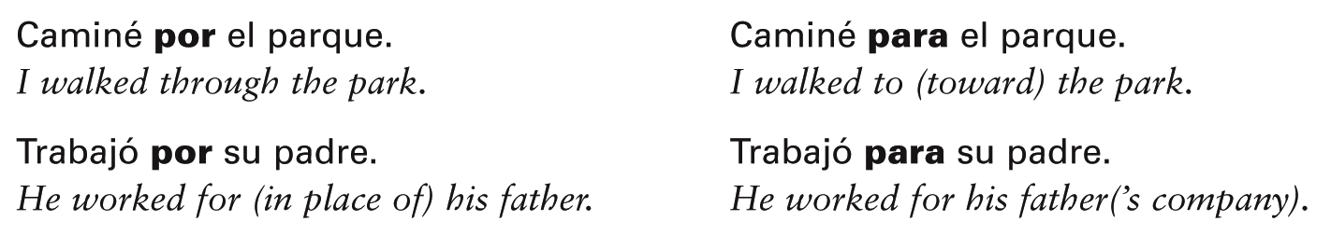
In many cases it is grammatically correct to use either por or para in a sentence. The meaning of the sentence is different, however, depending on which preposition
is used.
© by Vista Higher Learning, Inc. All rights reserved.
2.2-<number>

Slide 9

Completa estas oraciones con las preposiciones por o para.
Fuimos al cibercafé _____ la tarde. Necesitas un navegador GPS _____ encontrar la casa de Luis. Entraron _____ la puerta. Quiero un pasaje _____ Buenos Aires. _____ arrancar el carro, necesito la llave. Arreglé el televisor _____ mi amigo. Estuvieron nerviosos _____ el examen. ¿No hay una gasolinera _____ aquí? | El reproductor de MP3 es _____ usted. Juan está enfermo. Tengo que trabajar _____ él. Estuvimos en Canadá _____ dos meses. _____ mí, el español es fácil. Tengo que estudiar la lección _____ el lunes. Voy a ir _____ la carretera. Compré dulces _____ mi novia. Compramos el auto _____ un buen precio.
por
© by Vista Higher Learning, Inc. All rights reserved.
2.2-<number>

